Slide 1
FHIM/MDHT
Use of the NIEM Information Exchange Standard in Healthcare

Slide 2
NIEM and Healthcare
Information sharing between a variety of public agencies (e.g. criminal justice, health and human services, education) and healthcare providers has the potential to enhance care coordination and health outcomes by
reducing redundancies,
enhancing continuity of care, and
generating efficiencies in both domains.
Example: Bureau of Justice Assistance (DOJ) identified 34 exchange scenarios to enable communication between Criminal Justice (jails) and Community based health providers (e.g. mental health, substance abuse).

Slide 3
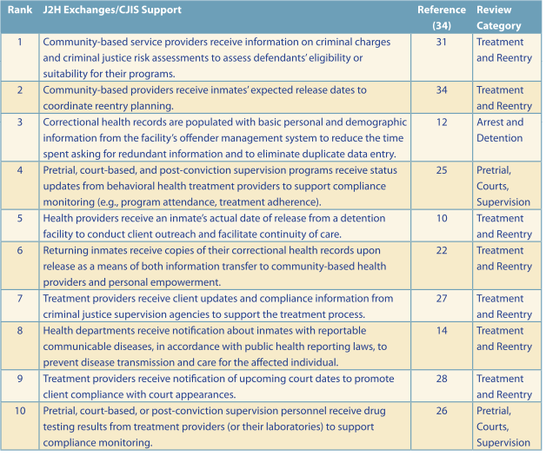
Justice-to-Health (J2H) Top 10 Information Exchanges
Exchange Scenario in the original Reentry Exchange report
Rank based on impact
Information Exchange Synopsis

Slide 4
FHIM/MDHT
The FHIM model and the MDHT tooling are perfectly positioned to bridge the semantic gap between domains and convey health information consistently regardless of context by allowing for the unambiguous definition of the exchange requirements in platform independent fashion.

Slide 5
NIEM Tooling Options to integrate with MDHT
Sparx System Enterprise
The Sparx system is a very populate modeling environment based on its low cost and ease of use. The primary issue with Sparx is the limited ability to generate compatible models outside of the tooling requiring the use of import features, which are not always complete.
MagicDraw NIEM Plugin
MagicDraw is a well-established UML modeling tool with a wide variety of extensions and features to support the development of architectures and software systems. The initial NIEM UML profile implementation for the OMG leveraged Magic Draw. Unlike Sparx, MagicDraw is based on the eclipse implementation of the UML standard allow for the generation of compatible models outside of MagicDraw.
NIEM Modeling Tool
The NIEM UML Modeling is an open source project built as an eclipse IDE application and available through GitHub. As mentioned, the tooling is based on the eclipse UML implementation so it is a straightforward process to create the models. The UI is based on the open source UML editor project Papyrus and as such is not as user friendly as the other two COTS products.

Slide 6
FHIM/MDHT/NIEM Going Forward
NIEM Modeling Tool is the best fit for the FHIM/MDHT
Need to determine status of project as there has been very little activity
Need to assimilate the NIEM Modeling Tooling into MDHT and Papyrus – Allowing for integrated desktop
Need to extend MDHT to generate a NIEM domain following FHIM approach

Slide 7
FHIM/MDHT Model Driven Approach for NIEM
Use FHIM/MDHT to define platform independent model of requirements
Leverage Model-to-Model transformations to produce platform specific model
Use platform specific model to generate artifacts

Slide 8
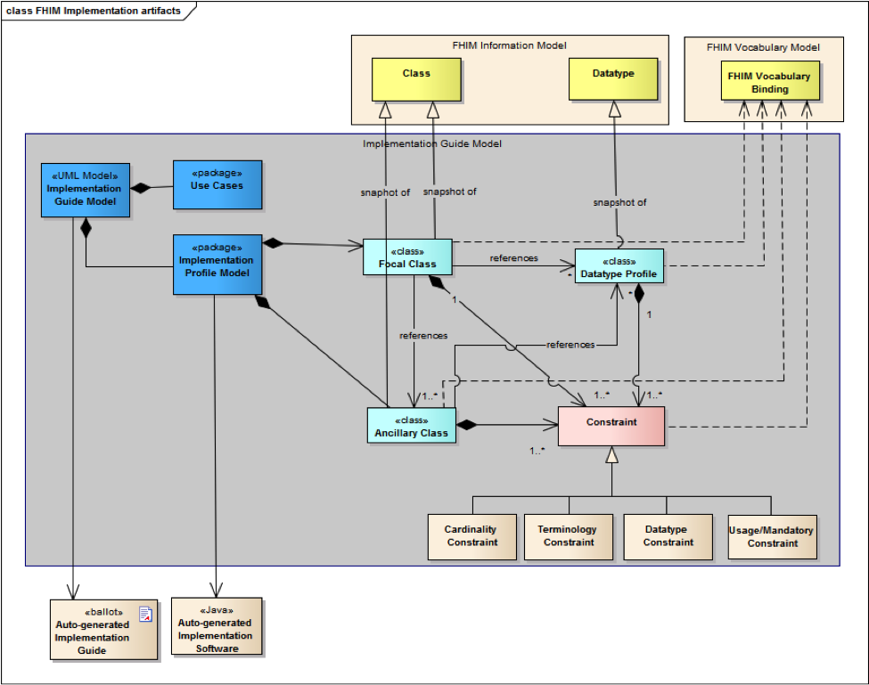
FHIM Implementation Artifacts
FHIM Information and Terminology
Use-case specific
implementation model
NIEM IEPD Information

Slide 9
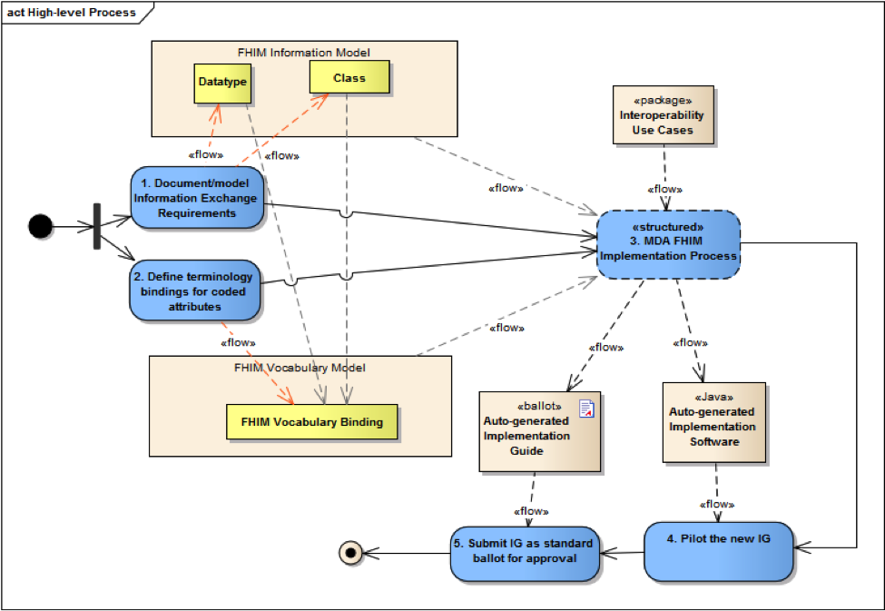
FHIM Information Model
NIEM IEPD Process
NIEM Data Requirements
MDHT/NIEM UML Tooling
NIEM Extensions and Specializations Identified
MDHT Terminology
FHIM Terminology
NIEM Pilot Implementation

